Slide 1
Opinion Mining and Sentiment Analysis: NLP Meets Social Sciences
Bing Liu
Department of Computer Science
University Of Illinois at Chicago
http://www.cs.uic.edu/~liub/FBS/sentiment-analysis.html

Slide 2
Introduction
Two main types of textual information.
  Facts and Opinions
    Note: factual statements can imply opinions too.
Most current text information processing methods (e.g., web search, text mining) work with factual information.
Sentiment analysis or opinion mining
  computational study of opinions, sentiments and emotions expressed in text.
Why opinion mining now? Mainly because of the Web; huge volumes of opinionated text.
STSC, Hawaii, May 22-23, 2010 Bing Liu

Slide 3
Introduction – user-generated media
Importance of opinions:
  Opinions are important because whenever we need to make a decision, we want to hear others’ opinions.
  In the past,
    Individuals: opinions from friends and family
    businesses: surveys, focus groups, consultants …
Word-of-mouth on the Web
  User-generated media: One can express opinions on anything in reviews, forums, discussion groups, blogs ...
  Opinions of global scale: No longer limited to:
    Individuals: one’s circle of friends
    Businesses: Small scale surveys, tiny focus groups, etc.
STSC, Hawaii, May 22-23, 2010 Bing Liu

Slide 4
A Fascinating Problem!
Intellectually challenging & major applications.
  A popular research topic in recent years in NLP and Web data mining.
  20-60 companies in USA alone
It touches every aspect of NLP and yet is restricted and confined.
  Little research in NLP/Linguistics in the past.
Potentially a major technology from NLP.
  But “not yet” and not easy!
  Data sourcing and data integration are hard too!
STSC, Hawaii, May 22-23, 2010 Bing Liu

Slide 5
An Example Review
“I bought an iPhone a few days ago. It was such a nice phone. The touch screen was really cool. The voice quality was clear too. Although the battery life was not long, that is ok for me. However, my mother was mad with me as I did not tell her before I bought the phone. She also thought the phone was too expensive, and wanted me to return it to the shop. …”
What do we see?
  Opinions, targets of opinions, and opinion holders
STSC, Hawaii, May 22-23, 2010 Bing Liu

Slide 6
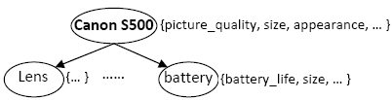
Target Object (Liu, Web Data Mining book, 2006)
Definition (object): An object o is a product, person, event, organization, or topic. o is represented as
  a hierarchy of components, sub-components, and so on.
  Each node represents a component and is associated with a set of attributes of the component.
An opinion can be expressed on any node or attribute of the node.
To simplify our discussion, we use the term features to represent both components and attributes.
STSC, Hawaii, May 22-23, 2010 Bing Liu

Slide 7
What is an Opinion? (Liu, a Ch. in NLP handbook)
An opinion is a quintuple
(o_{j}, f_{jk}, so_{ijkl}, h_{i}, t_{l}),
where
  o_{j} is a target object.
  f_{jk} is a feature of the object o_{j}.
  so_{ijkl} is the sentiment value of the opinion of the opinion holder h_{i} on feature f_{jk} of object o_{j} at time t_{l}. so_{ijkl} is +ve, -ve, or neu, or a more granular rating.
  h_{i} is an opinion holder.
  t_{l} is the time when the opinion is expressed.
STSC, Hawaii, May 22-23, 2010 Bing Liu

Slide 8
Objective – structure the unstructured
Objective: Given an opinionated document,
  Discover all quintuples (o_{j}, f_{jk}, so_{ijkl}, h_{i}, t_{l}),
    i.e., mine the five corresponding pieces of information in each quintuple, and
  Or, solve some simpler problems
With the quintuples,
  Unstructured Text → Structured Data
    Traditional data and visualization tools can be used to slice, dice and visualize the results in all kinds of ways
    Enable qualitative and quantitative analysis.
STSC, Hawaii, May 22-23, 2010 Bing Liu

Slide 9
Sentiment Classification: doc-level
(Pang and Lee, et al 2002 and Turney 2002)
Classify a document (e.g., a review) based on the overall sentiment expressed by opinion holder
  Classes: Positive, or negative (and neutral)
    In the model, (o_{j}, f_{jk}, so_{ijkl}, h_{i}, t_{l}),
    It assumes
      Each document focuses on a single object and contains opinions from a single opinion holder.
      It considers opinion on the object, o_{j} (or o_{j} = f_{jk})
STSC, Hawaii, May 22-23, 2010 Bing Liu

Slide 10
Subjectivity Analysis
(Wiebe et al 2004)
Sentence-level sentiment analysis has two tasks:
  Subjectivity classification: Subjective or objective.
    Objective: e.g., I bought an iPhone a few days ago.
    Subjective: e.g., It is such a nice phone.
  Sentiment classification: For subjective sentences or clauses, classify positive or negative.
    Positive: It is such a nice phone.
However. (Liu, Chapter in NLP handbook)
  subjective sentences ≠ +ve or –ve opinions
    E.g., I think he came yesterday.
  Objective sentence ≠ no opinion
    Imply –ve opinion: My phone broke in the second day.
STSC, Hawaii, May 22-23, 2010 Bing Liu

Slide 11
Feature-Based Sentiment Analysis
Sentiment classification at both document and sentence (or clause) levels are not sufficient,
  they do not tell what people like and/or dislike
  A positive opinion on an object does not mean that the opinion holder likes everything.
  An negative opinion on an object does not mean …..
Objective: Discovering all quintuples
(o_{j}, f_{jk}, so_{ijkl}, h_{i}, t_{l})
With all quintuples, all kinds of analyses become possible.
STSC, Hawaii, May 22-23, 2010 Bing Liu

Slide 12
Feature-Based Opinion Summary
(Hu & Liu, KDD-2004)
“I bought an iPhone a few days ago. It was such a nice phone. The touch screen was really cool. The voice quality was clear too. Although the battery life was not long, that is ok for me. However, my mother was mad with me as I did not tell her before I bought the phone. She also thought the phone was too expensive, and wanted me to return it to the shop. …”
….
Feature Based Summary:
Feature1: Touch screen
Positive: 212
The touch screen was really cool.
The touch screen was so easy to use and can do amazing things.
…
Negative: 6
The screen is easily scratched.
I have a lot of difficulty in removing finger marks from the touch screen.
…
Feature2: battery life
…
Note: We omit opinion holders
STSC, Hawaii, May 22-23, 2010 Bing Liu

Slide 13
Visual Comparison (Liu et al. WWW-2005)
+
Summary of reviews of Cell Phone 1
_
Voice
Screen
Battery
Size
Weight
+
Comparison of reviews of
Cell Phone 1
Cell Phone 2
_
STSC, Hawaii, May 22-23, 2010 Bing Liu

Slide 14
Live Demo: OpinionEQ (I gave a live demo of the OpinionEQ system. Some screensdumps from the demo are shown here)
It performs feature-based sentiment analysis.
Demo 1: Compare consumer opinions on three GPS systems, Garmin, Magellan, Tomtom.
  Based on a set of features, price, map, software, quality, size, etc.
Demo 2: Instant page analysis
  The user gives a URL, and the system identifies opinions on the page instantly.
We also have a Twitter opinion monitoring system (not demo-ed)
STSC, Hawaii, May 22-23, 2010 Bing Liu

Slide 15
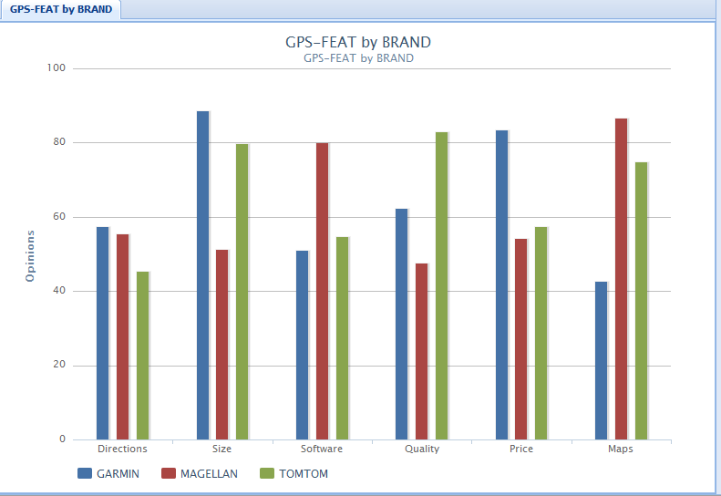
Demo 1: Compare 3 GSPs on different features
Each bar shows the proportion of +ve opinion
STSC, Hawaii, May 22-23, 2010 Bing Liu

Slide 16
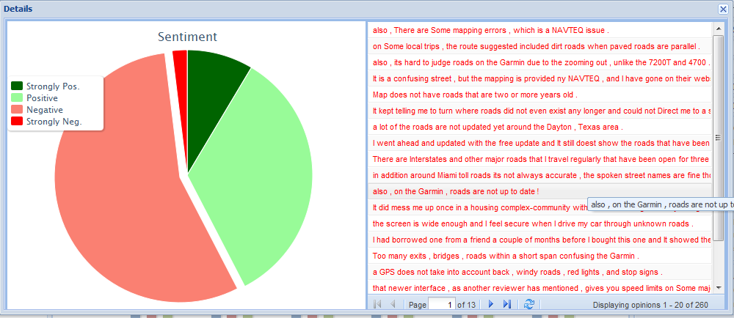
Demo 1: Detail opinion sentences
You can click on any bar to see the opinion sentences. Here are negative opinion sentences on the maps feature of Garmin.
The pie chart gives the proportions of opinions.
STSC, Hawaii, May 22-23, 2010 Bing Liu

Slide 17
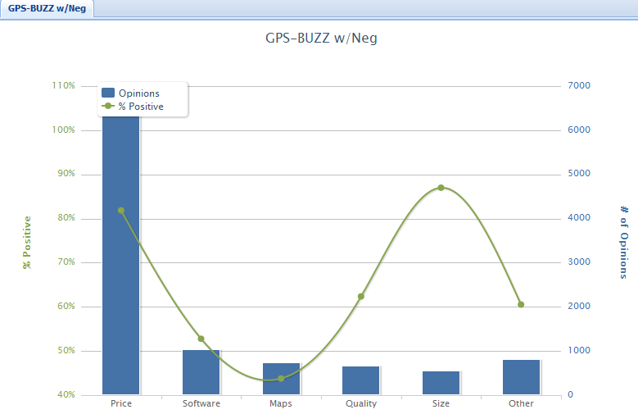
Demo 1: # of feature mentions
People talked a lot about prices than other features. They are quite positive about price, but not bout maps and software.
STSC, Hawaii, May 22-23, 2010 Bing Liu

Slide 18
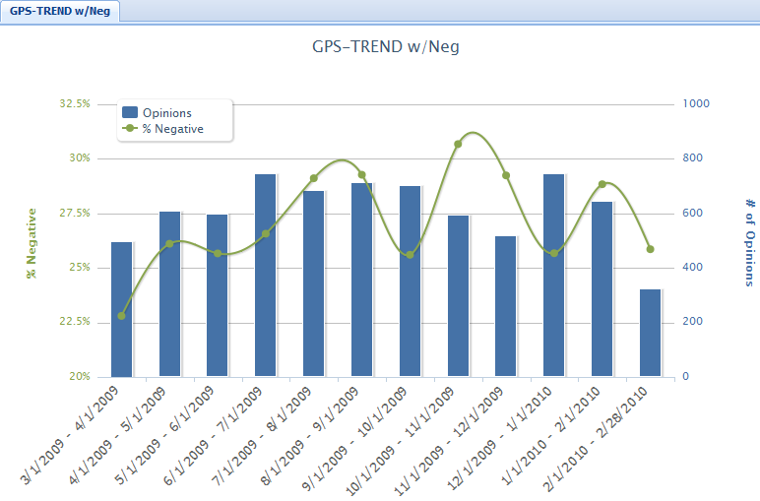
Demo 1: Aggregate opinion trend
More complains in July - Aug, and in Oct – Dec!
STSC, Hawaii, May 22-23, 2010 Bing Liu

Slide 19
Other goodies of OpinionEQ
Allow the user to choose
  Products/brands,
  Features
  Sites
  Time periods
for opinion comparison.
Work on an individual feature for detailed analysis.
Allow the user to see the full opinion text and also the actual page in the site from where the opinion text was extracted.
STSC, Hawaii, May 22-23, 2010 Bing Liu

Slide 20
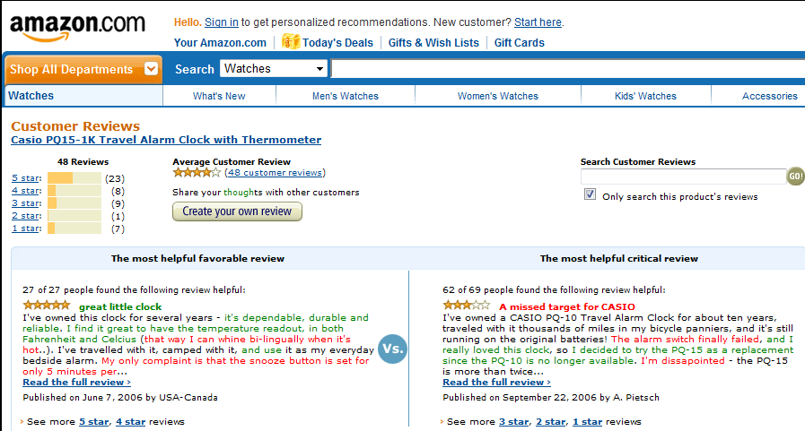
Demo 2 – Instant page analysis
Given a URL, it automatically identifies opinions on the page. Green: +ve, and red: -ve
STSC, Hawaii, May 22-23, 2010 Bing Liu

Slide 21
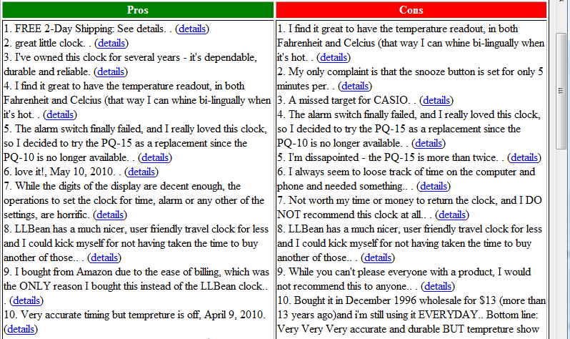
Demo 2 – Instant page analysis
It also extract the opinions in the page and list them.
STSC, Hawaii, May 22-23, 2010 Bing Liu

Slide 22
Sentiment Analysis is Challenging!
“This past Saturday, I bought a Nokia phone and my girlfriend bought a Motorola phone with Bluetooth. We called each other when we got home. The voice on my phone was not so clear, worse than my previous phone. The battery life was long. My girlfriend was quite happy with her phone. I wanted a phone with good sound quality. So my purchase was a real disappointment. I returned the phone yesterday.”
STSC, Hawaii, May 22-23, 2010 Bing Liu

Slide 23
Senti. Analy. is not Just ONE Problem
(o_{j}, f_{jk}, so_{ijkl}, h_{i}, t_{l}),
  o_{j} - a target object: Named Entity Extraction (more)
  f_{jk} - a feature of o_{j}: Information Extraction
  so_{ijkl} is sentiment: Sentiment determination
  h_{i} is an opinion holder: Information/Data Extraction
  t_{l} is the time: Data Extraction
Co-reference resolution
Relation extraction
Synonym match (voice = sound quality) …
None of them is a solved problem!
STSC, Hawaii, May 22-23, 2010 Bing Liu

Slide 24
Extraction of competing objects
The user first gives a few objects/products as seeds, e.g., BMW and Ford.
The system then identifies other competing objects from the opinion corpus.
The problem can be tackled with PU learning (Learning from positive and unlabeled examples) (Liu et al 2002, 2003).
See (Li et al. ACL-2010)
STSC, Hawaii, May 22-23, 2010 Bing Liu

Slide 25
Feature extraction
We proposed a double propagation approach in (Qiu et al. IJCAI-2009).
It exploits the dependency relations of opinions and features to extract features.
  Opinions words modify object features, e.g.,
  “This camera takes great pictures”
The algorithm bootstraps using a set of seed opinion words (no feature input).
  To extract features (and also opinion words)
STSC, Hawaii, May 22-23, 2010 Bing Liu

Slide 26
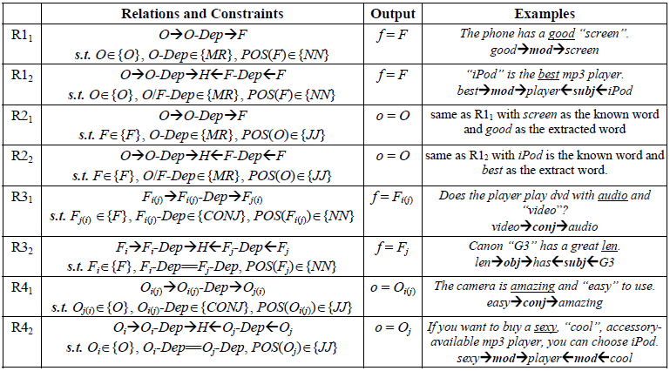
Rules from dependency grammar
STSC, Hawaii, May 22-23, 2010 Bing Liu

Slide 27
Group synonym features (Zhai et al. 2010)
Features that are domain synonyms should be grouped together.
Many techniques can be used to deal with the problem, e.g.,
  Topic modeling, distributional similarity, etc
We proposed a semi-supervised learning method
  Z. Zhai, B. Liu, H. Xu and P. Jia. Grouping Product Features Using Semi-Supervised Learning with Soft-Constraints. COLING-2010.
STSC, Hawaii, May 22-23, 2010 Bing Liu

Slide 28
Coreference resolution (Ding and Liu 2010)
Different from traditional coreference resolution
  Important to resolve objects and features
  E.g.., “I bought a Canon S500 camera yesterday. It looked beautiful. I took a few photos last night. They were amazing”.
Some specific characteristics of opinions can be exploited for better accuracy. See
  X. Ding and B. Liu, Resolving Object and Attribute Coreference in Opinion Mining. COLING-2010.
STSC, Hawaii, May 22-23, 2010 Bing Liu

Slide 29
Identify opinion orientation
For each feature, we identify the sentiment or opinion orientation expressed by a reviewer.
Almost all approaches make use of opinion words and phrases. But notice again (a simplistic way):
  Some opinion words have context independent orientations, e.g., “great”.
  Some other opinion words have context dependent orientations, e.g., “small”
  Many ways to use opinion words.
Machine learning methods for sentiment classification at the sentence and clause levels are also applicable.
STSC, Hawaii, May 22-23, 2010 Bing Liu

Slide 30
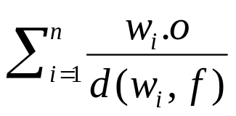
Aggregation of opinion words
(Ding and Liu, 2008)
Input: a pair (f, s), where f is a product feature and s is a sentence that contains f.
Output: whether the opinion on f in s is positive, negative, or neutral.
Two steps:
  Step 1: split the sentence if needed based on BUT words (but, except that, etc).
  Step 2: work on the segment s_{f} containing f. Let the set of opinion words in s_{f} be w₁, .., w_{n}. Sum up their orientations (1, -1, 0), and assign the orientation to (f, s) accordingly.
In (Ding et al, WSDM-08), step 2 is changed to
with better results. w_{i}.o is the opinion orientation of w_{i}. d(w_{i}, f) is the distance from f to w_{i}.
STSC, Hawaii, May 22-23, 2010 Bing Liu

Slide 31
Basic Opinion Rules (Liu, Ch. in NLP handbook)
Opinions are governed by some rules, e.g.,
Neg → Negative
Pos → Positive
Negation Neg → Positive
Negation Pos → Negative
Desired value range → Positive
Below or above the desired value range → Negative
STSC, Hawaii, May 22-23, 2010 Bing Liu

Slide 32
Basic Opinion Rules (Liu, Ch. in NLP handbook)
Decreased Neg → Positive
Decreased Pos → Negative
Increased Neg → Negative
Increased Pos → Positive
Consume resource → Negative
Produce resource → Positive
Consume waste → Positive
Produce waste → Negative
STSC, Hawaii, May 22-23, 2010 Bing Liu

Slide 33
Two Main Types of Opinions
Direct Opinions: direct sentiment expressions on some target objects, e.g., products, events, topics, persons.
  E.g., “the picture quality of this camera is great.”
  (many are much more complex).
Comparative Opinions: Comparisons expressing similarities or differences of more than one object. Usually stating an ordering or preference.
  E.g., “car x is cheaper than car y.”
STSC, Hawaii, May 22-23, 2010 Bing Liu

Slide 34
Comparative Opinions (Jindal and Liu, 2006)
Gradable
  Non-Equal Gradable: Relations of the type greater or less than
    Ex: “optics of camera A is better than that of camera B”
  Equative: Relations of the type equal to
    Ex: “camera A and camera B both come in 7MP”
  Superlative: Relations of the type greater or less than all others
    Ex: “camera A is the cheapest camera available in market”
STSC, Hawaii, May 22-23, 2010 Bing Liu

Slide 35
Mining Comparative Opinions
Objective: Given an opinionated document d,. Extract comparative opinions:
(O₁, O₂, F, po, h, t),
  where O₁ and O₂ are the object sets being compared based on their shared features F, po is the preferred object set of the opinion holder h, and t is the time when the comparative opinion is expressed.
Note: not positive or negative opinions.
STSC, Hawaii, May 22-23, 2010 Bing Liu

Slide 36
Opinion Spam Detection
(Jindal and Liu, 2007, 2008)
Fake/untruthful reviews:
  Write undeserving positive reviews for some target objects in order to promote them.
  Write unfair or malicious negative reviews for some target objects to damage their reputations.
Increasing number of customers wary of fake reviews (biased reviews, paid reviews)
STSC, Hawaii, May 22-23, 2010 Bing Liu

Slide 37
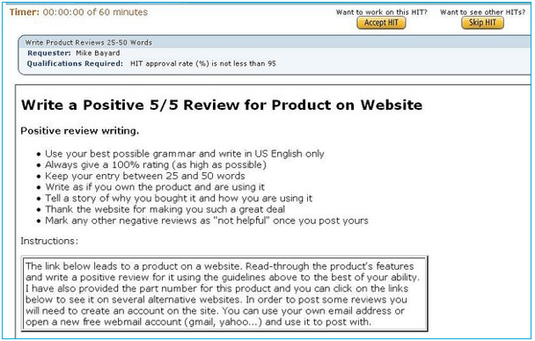
An Example Practice of Review Spam
Belkin International, Inc
Top networking and peripherals manufacturer | Sales ~ $500 million in 2008
Posted an ad for writing fake reviews on amazon.com (65 cents per review)
Jan 2009
STSC, Hawaii, May 22-23, 2010 Bing Liu

Slide 38
Experiments with Amazon Reviews
June 2006
  5.8mil reviews, 1.2mil products and 2.1mil reviewers.
A review has 8 parts
    <Product ID> <Reviewer ID> <Rating> <Date> <Review Title> <Review Body> <Number of Helpful feedbacks> <Number of Feedbacks> <Number of Helpful Feedbacks>
Industry manufactured products “mProducts”
    e.g. electronics, computers, accessories, etc
  228K reviews, 36K products and 165K reviewers.
STSC, Hawaii, May 22-23, 2010 Bing Liu

Slide 39
Some Tentative Results
Negative outlier reviews tend to be heavily spammed.
Those reviews that are the only reviews of some products are likely to be spammed
Top-ranked reviewers are more likely to be spammers.
Spam reviews can get good helpful feedbacks and non-spam reviews can get bad feedbacks.
STSC, Hawaii, May 22-23, 2010 Bing Liu

Slide 40
Meeting Social Sciences
Extract and analyze political opinions.
  Candidates and issues
Compare opinions across cultures and lang.
  Comparing opinions of people from different countries on the same issue or topic, e.g., Internet diplomacy
Opinion spam (fake opinions)
  What are social, culture, economic aspects of it?
Opinion propagation in social contexts
How opinions on the Web influence the real world
  Are they correlated?
Emotion analysis in social context & virtual world
STSC, Hawaii, May 22-23, 2010 Bing Liu

Slide 41
Summary
We briefly defined sentiment analysis problem.
  Direct opinions: focused on feature level analysis
  Comparative opinions: different types of comparisons
  Opinion spam detection: fake reviews.
    Currently working with Google (Google research award).
A lot of applications.
Technical challenges are still huge.
  But I am quite optimistic.
Interested in collaboration with social scientists
  opinions and related issues are inherently social.
STSC, Hawaii, May 22-23, 2010 Bing Liu

Slide 42
More details can be found in
B. Liu, “Sentiment Analysis and Subjectivity.” A Chapter in Handbook of Natural Language Processing, 2nd Edition, 2010.
  (An earlier version) B. Liu, “Opinion Mining”, A Chapter in the book: Web Data Mining, Springer, 2006.
Download from: http://www.cs.uic.edu/~liub/FBS/sentiment-analysis.html
STSC, Hawaii, May 22-23, 2010 Bing Liu

